Slide 1
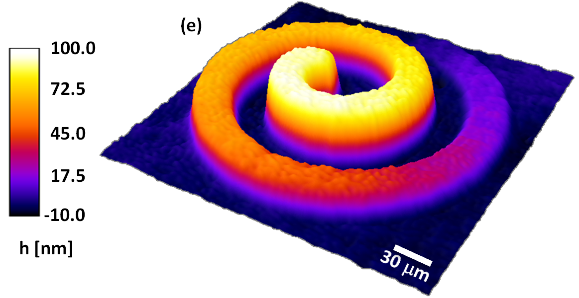
Low-Cost Photochemical Etching with a Projector (PCEP)
Terry Koker¹, Kaiyuan Wang², Lynford Goddard^{2,3}
¹Mahomet-Seymour High School, ²Electrical and Computer Engineering, ³Micro and Nanotechnology Laboratory, University of Illinois.

Slide 2
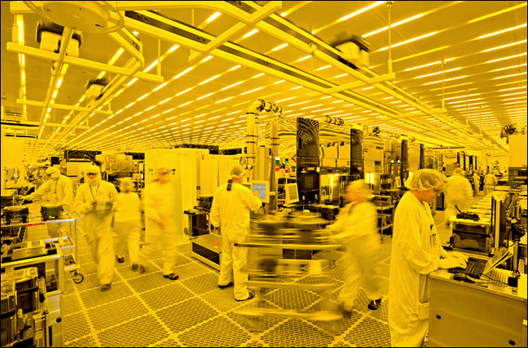
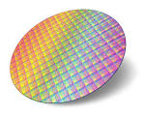
Principles of Semiconductor Fabrication
Doping p-type or n-type
Etching a pattern with photoresist
Intel you tube video

Slide 3
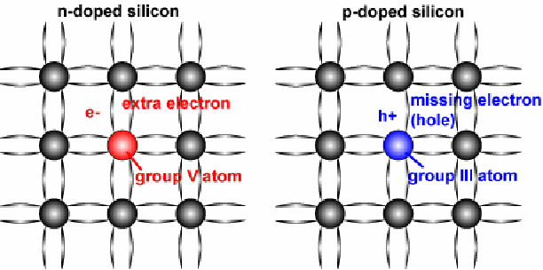
Doping p-type or n-type
Undoped silicon at room temperature has
some electrons in the conduction band and
holes in the valence band for carrying electricity.
Doped silicon has extra electrons in the
conduction band (n-type) or extra holes in
the valence band (p-type), increasing
conductivity.

Slide 4
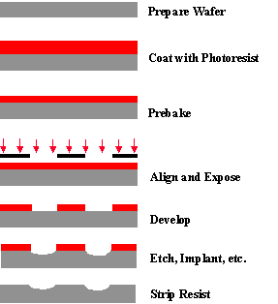
Etching a Pattern with Photoresist

Slide 5
Alternative PCEP Technique
Simplified technique
taking advantage of the
increased rate of etching
at point of illumination.

Slide 6
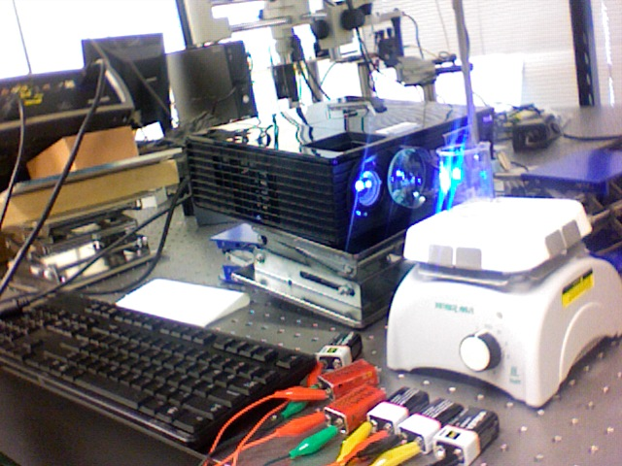

Slide 7
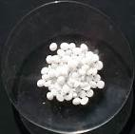
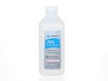
The Etchant
H₂O/KOH/Isopropyl Alcohol

Slide 8
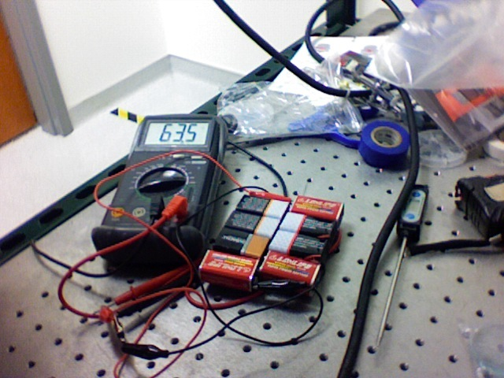
Adding Bias
PECEP-Photoelectrochemical Etching with Projector
Literature indicated that cathodic bias (about-60V) would give best selectivity.³
Keeps the surface from forming an impenetrable oxide coating.

Slide 9
Experimental Parameters Optimized
Semiconductor Etched-100 orientation p-Si Resistivity 6.3-8.5 Ω.cm
Wet etchant (13 DI H₂O:6 KOH:1 IPA)
Temperature (about 60ºC)
Stirring or not stirring (bubbling mixes etchant)
Light source (projector or laser)
Orientation of sample (Horizontal/Vertical/Diagonal)
Bias (Cathodic about -60V)

Slide 10
Success!
A standard method was developed to produce good resolution images with limited “frosting” of the silicon.
The bubbling actually makes the image visible “during” etching.

Slide 11
Chemistry
Redox reaction⁴
Oxidation-Si + 2 OH⁻ → Si(OH)₂²⁺ + 4e⁻
Reduction-4H₂O + 4e⁻ → 4OH⁻ + 2 H₂
Overall reaction
Si + 4 H₂O → Si(OH)₂²⁺ + 2 H₂ + 2 OH⁻
Kinetics
Factors that affect the rate of reaction
Temperature
Bias
Light
Minority carriers

Slide 12
References
1. C. Edwards, K. Wang, R. Zhou, B. Bhaduri, G. Popescu, and L. Goddard, “Digital projection photochemical etching defines gray-scale features,” Opt. Express 21(11), 13547-13554 (2013).
2. C. Edwards, A. Arbabi, G. Popescu, and L. Goddard, “Optically monitoring and controlling nanoscale topography during semiconductor etching,” Nature- Light: Science & Applications, 1(e30), (2012).
3. D. Starosvetsky, M. Kovler, and J. Yahalom, “Electrochemical etching of silicon in aqueous solution: SPIE Vol. 3680, 1083-1090 (1999).
4. H. Seidel, L. Csepregi, A. Heuberger, and H. Baumgartel, “Anisotropic Etching of Crystalline Silicon in Alkaline Solutions” J. Electrochem. Soc., 137 (11) 3612-3626 (1990).

Slide 13
Acknowledgments
Financial support was provided by the National Science Foundation under grant #NSF EEC 14-07194 RET.
Personally, I would like to thank my research mentor, Kaiyuan Wang for his patience and expertise and my research advisor, Lynford Goddard for devising this project and providing resources and guidance. Additionally, Dr. Glennys Mensing was very helpful as a consultant on experimental procedures. I would also like to thank the staff at the Micro and Nanotechnology Laboratory (MNTL) for hosting our RET experience, especially Carrie Kouadio and Dot Gordon. Also, the three other RET teachers, David Bergandine, Dan Reid, and Aubrey Wachtel for their support and collegiality. Furthermore, I thank my principal, Shannon Cheek, at Mahomet-Seymour High School, for his support of my participation in the RET program. Finally, I’d like to thank my wife Annette, and my son Austin, for giving up their time with me this summer so I could go play in the lab.
For more information, contact Terry Koker, tkoker@ms.k12.il.us

